Slide 1




INSURE
HUB
Created by Team-2

Slide 2

TEAM MEMBERS
ITASHI
JESSICA REEHAL
ARUN SINGH
VINAY KUMAR
ANKIT KUMAR

Slide 3
Table of
Content
Our Team
Problem Statement
Objectives
Microservices
Project Overview
Architecture
Project Flow
Future Scope

Slide 4

PROBLEM STATEMENT
Inefficient and complex insurance processes .
Absence of a user-friendly insurance application .
Lack sufficient education about insurance, impeding their ability to make informed decisions.

Slide 5
OBJECTIVE
The objective of creating an insurance application is to streamline the insurance experience for individuals and businesses.
This application aims to provide a user-friendly platform that simplifies the understanding, purchase, and management of insurance policies.

Slide 6
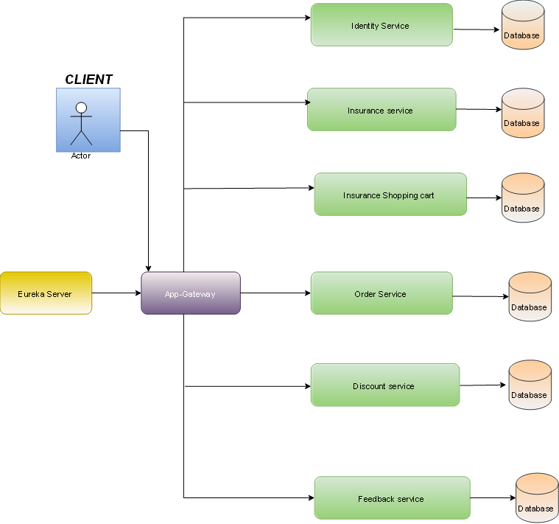
Project Overview

Slide 7
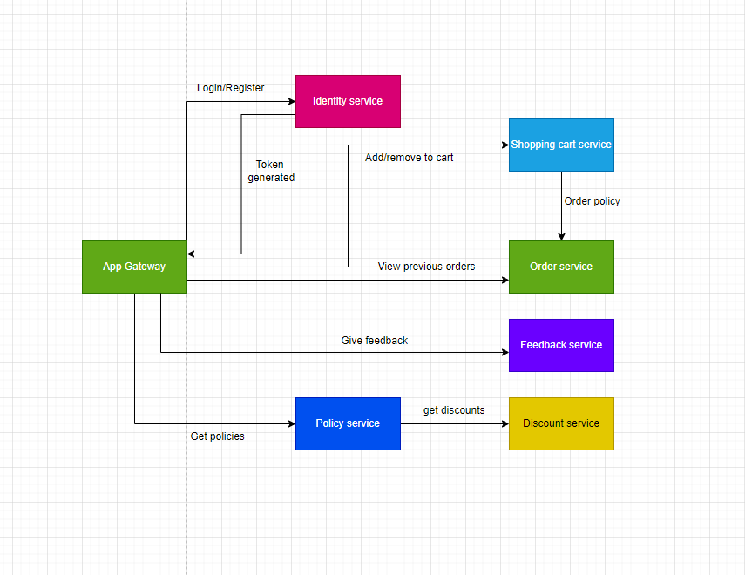
Project Architecture

Slide 8
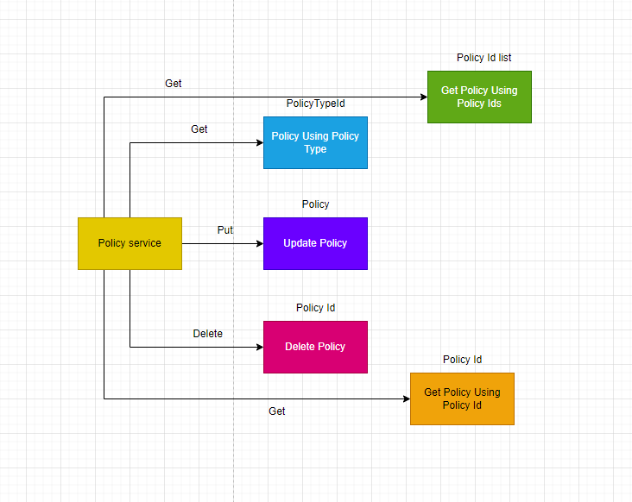
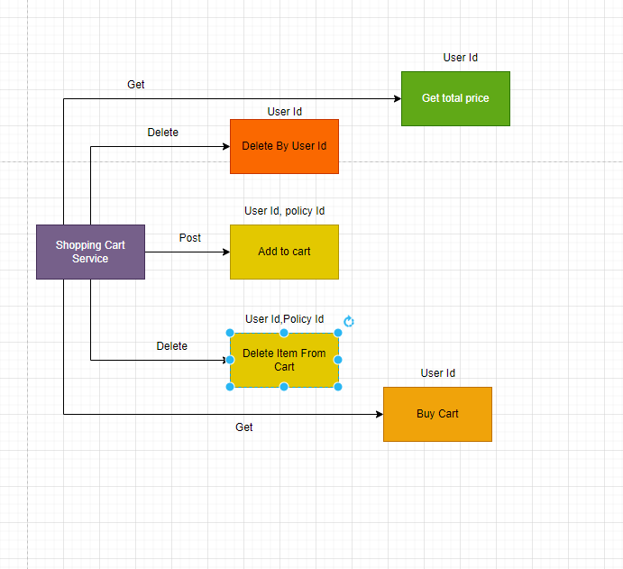

Slide 9
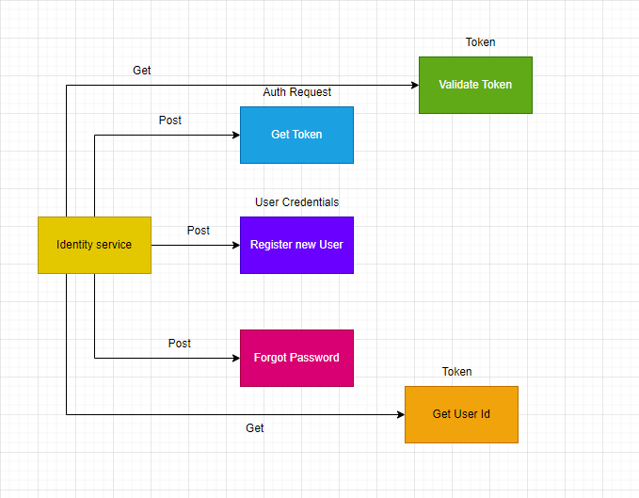
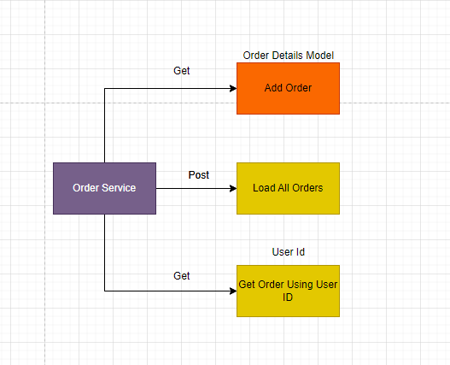

Slide 10
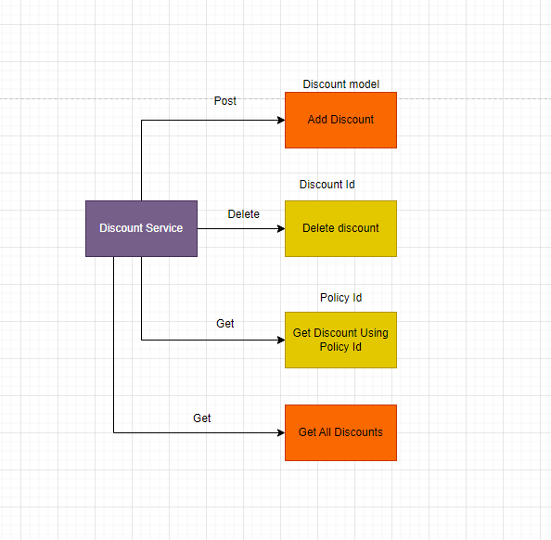
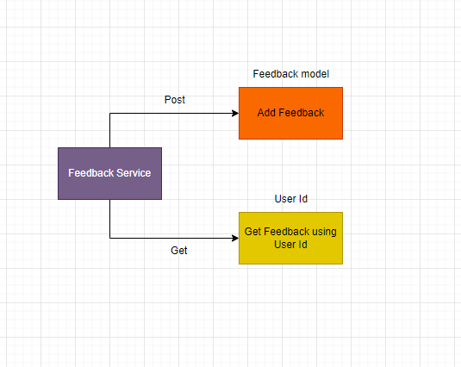

Slide 11
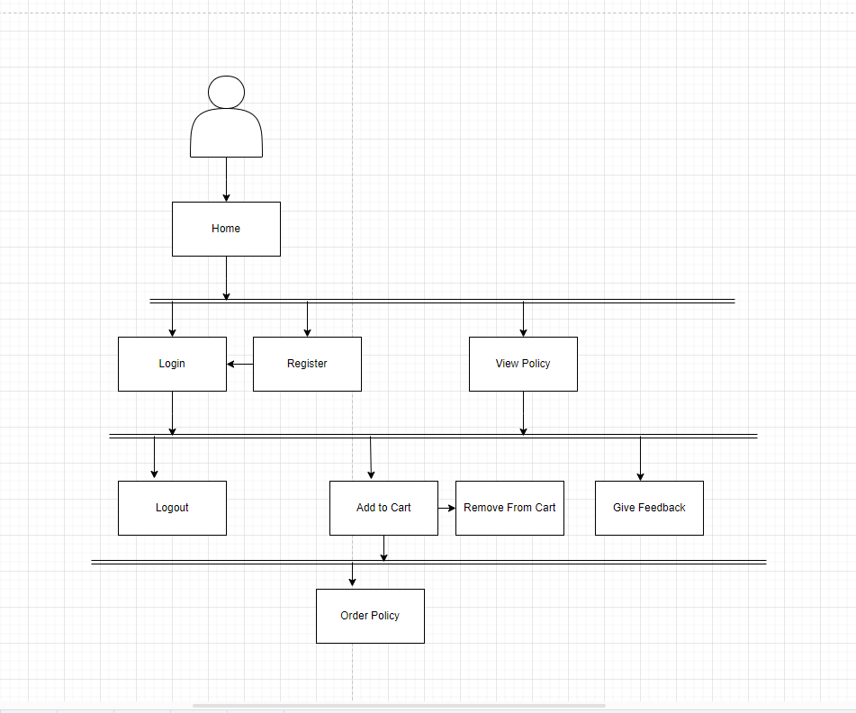

Slide 12











TECHNOLOGIES USED

Slide 13




Future Scope
Blockchain Implementation for Enhanced Security
Integration of Chatbot Functionality
Leveraging Recommendation Systems
Utilization of Machine Learning Algorithms for Predictive Analysis
Implementation of Multi-factor Authentication (MFA)
+123-456-7890
www.reallygreatsite.com
123 Anywhere St., Any City, ST 12345

Slide 14
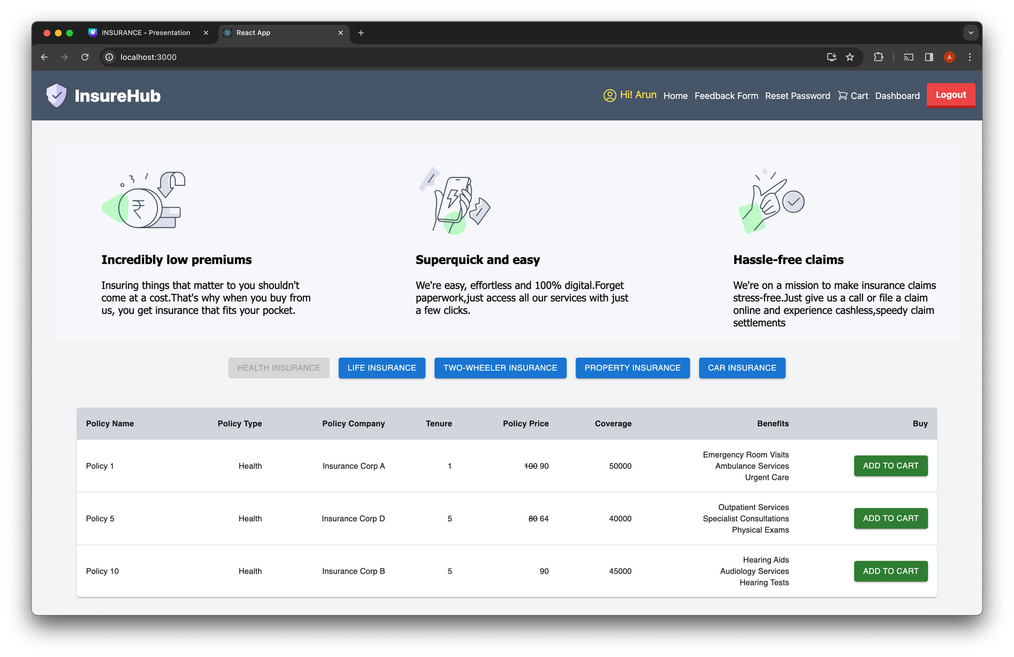

Slide 15
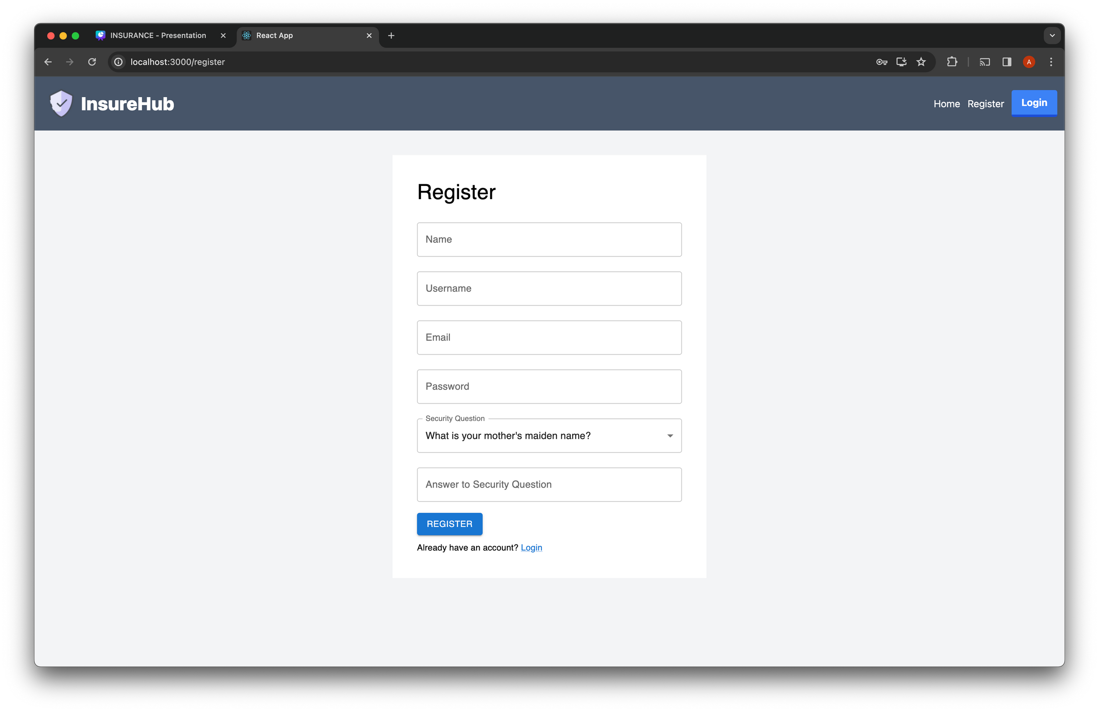

Slide 16
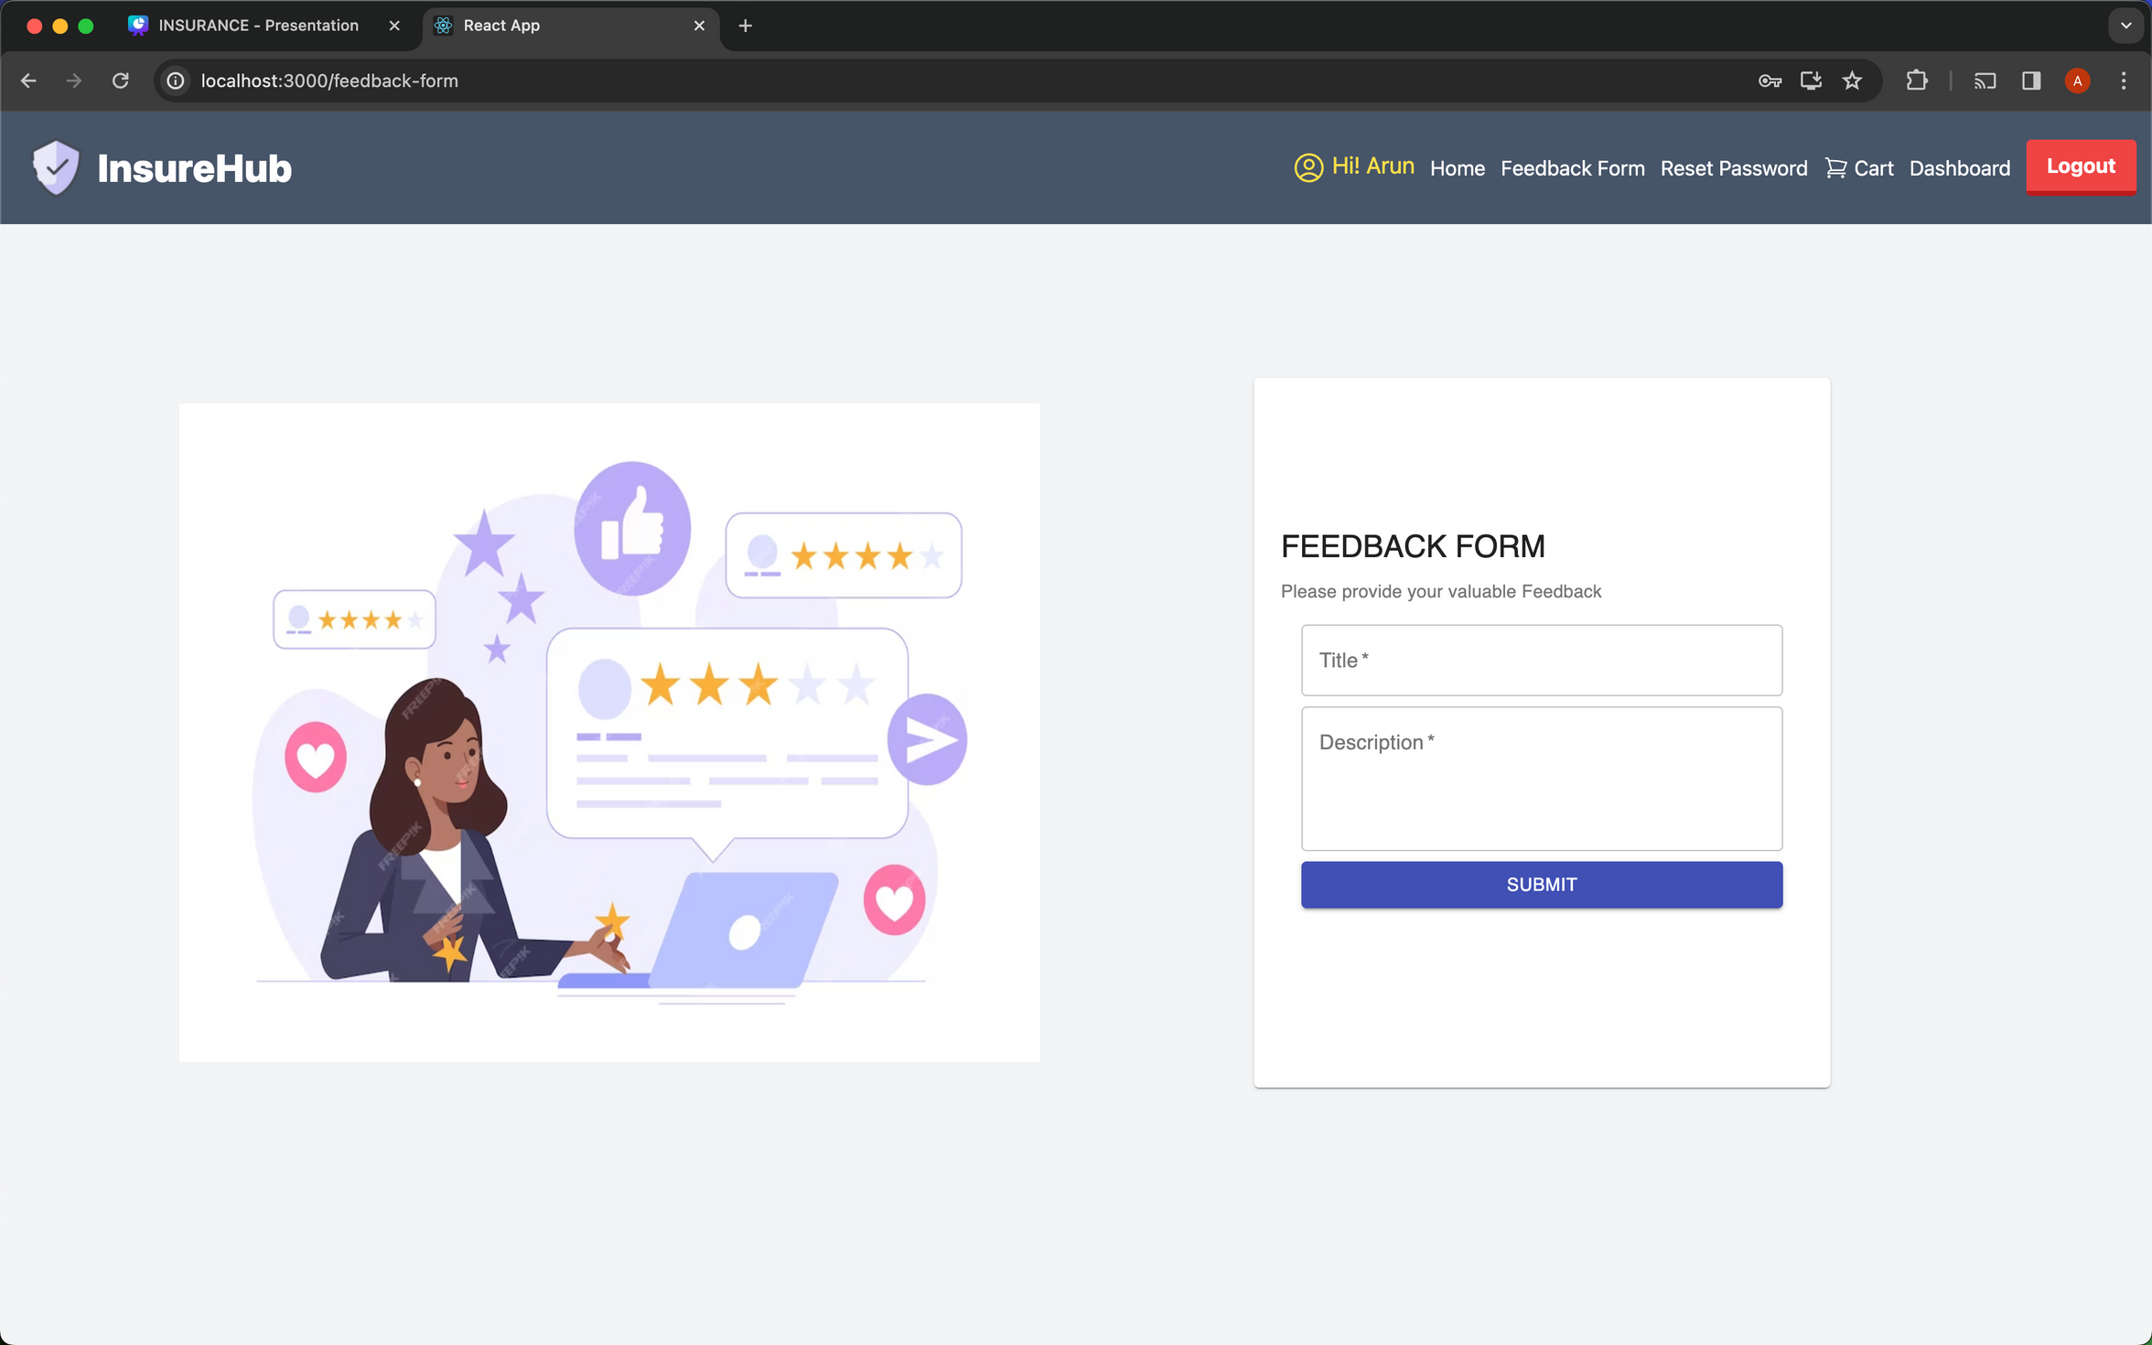

Slide 17
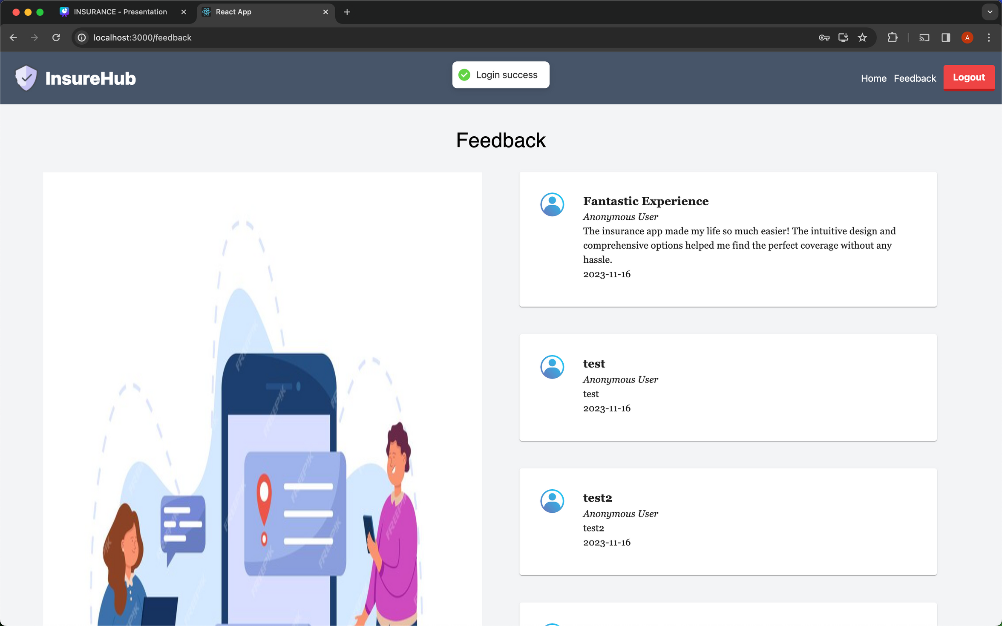

Slide 18
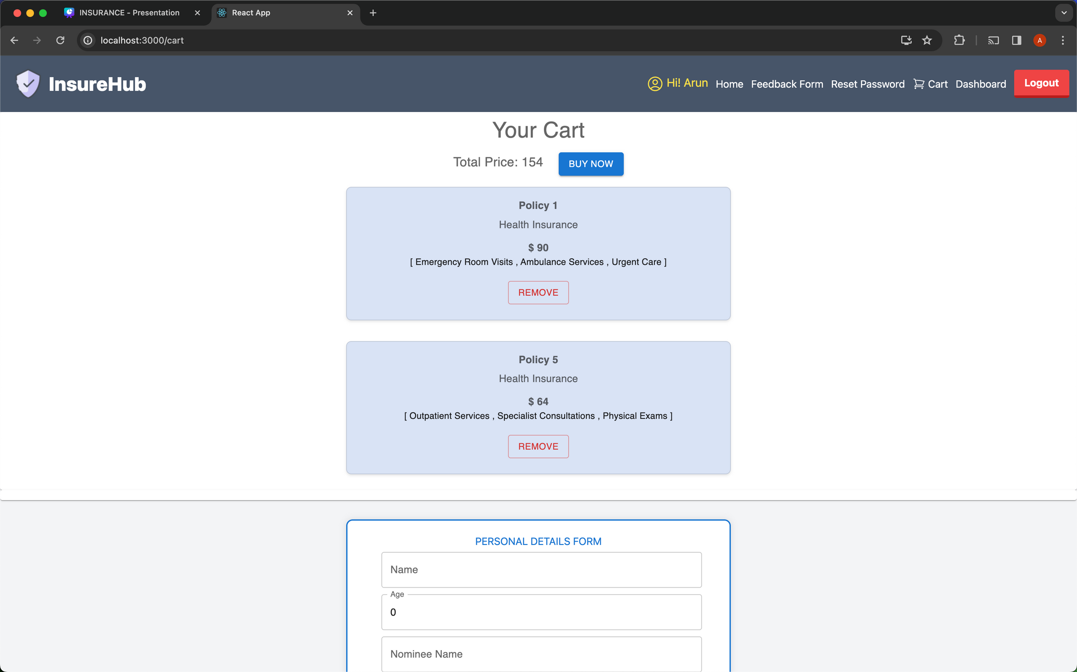

Slide 19
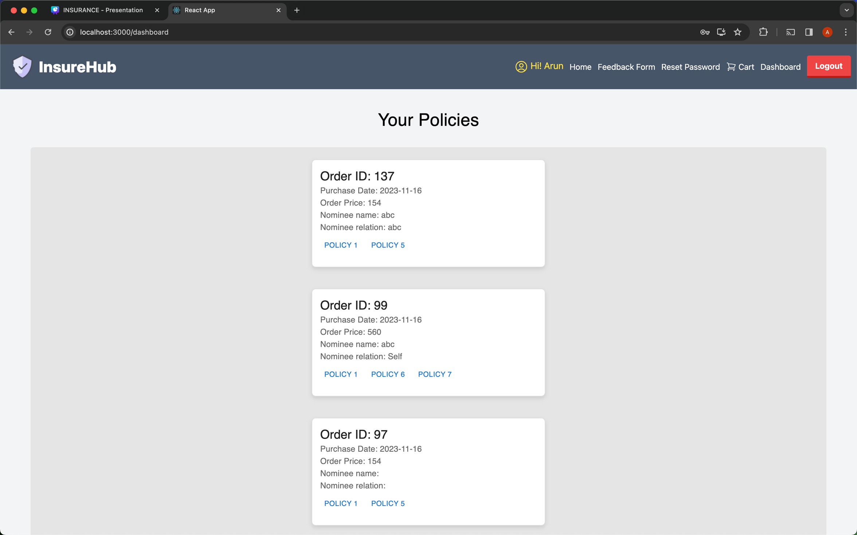

Slide 20
Thank You

